Slide 1



Hackathon 2025
MCP + LangChain

Slide 2
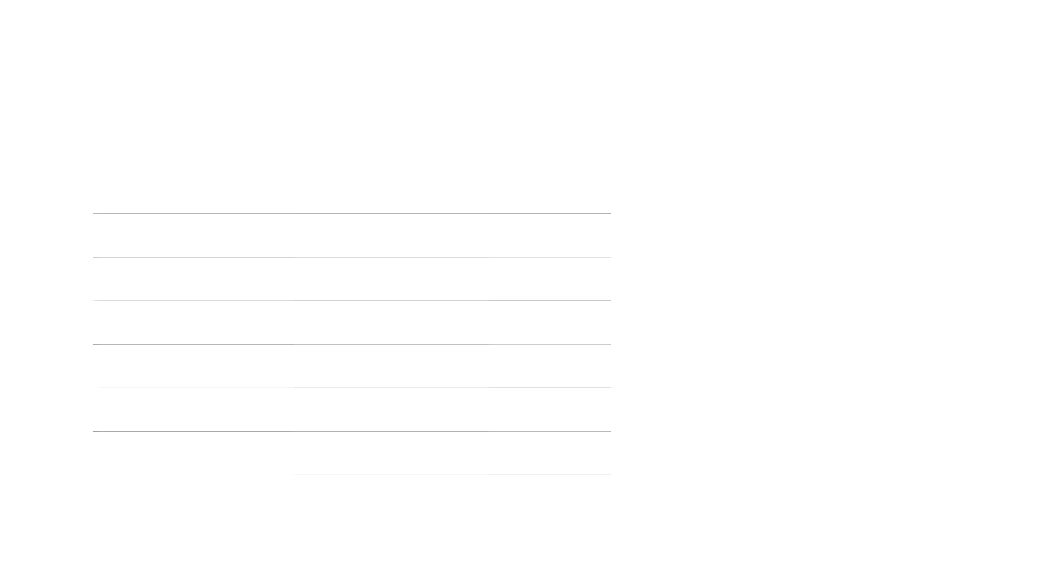

Schedule
[9:00 – 9:30]
Kickoff and intros
[9:30 - 10:00]
Repo walkthrough and setup
[10:00 – 10:30]
Team formation and scenario selection
[10:30 - 12:30]
Build time
[12:30 - 1:30]
Lunch
[1:30 - 4:45]
Build time
[4:45 - 5:25]
Demos
[5:25 - 5:30]
Wrap-up

Slide 3


Goals
Learn how to create an MCP server
Create an agent using LangChain
Solve a problem using an MCP + LangChain agent
Have fun!

Slide 4


Teams
Teams of 4-5 Each team has a tech lead (always a NO member) Tech lead forks the main repo and opens a PR back to main Tech lead grants access to their forked repo for all team members We will use Teams breakout rooms like last time Tech lead ensures the PowerPoint is filled in for the end-of-day demo

Slide 5
Intro to the repo

Slide 6



Demo
Each team will do a demo
Make your demo fun!

Slide 7
Any Questions?

Slide 8


Thanks for coming

